Slide 1
Creational Design Patterns
Mahesh Shirole
VJTI, Matunga Mumbai

Slide 2
Creational Design Patterns
In software engineering, creational design patterns are design patterns that deal with object creation mechanisms, trying to create objects in a manner suitable to the situation
The basic form of object creation could result in design problems or in added complexity to the design
Creational design patterns solve this problem by somehow controlling this object creation

Slide 3
Creational Design Patterns
Deal with one of the most commonly performed tasks in an OO application, the creation of objects
Support a uniform, simple, and controlled mechanism to create objects.
Allow the encapsulation of the details about what classes are instantiated and how these instances are created
Encourage the use of interfaces, which reduces coupling

Slide 4
Creational Design Patterns
There are following 6 types of creational design patterns.
Factory Method Pattern
Abstract Factory Pattern
Singleton Pattern
Prototype Pattern
Builder Pattern
Object Pool Pattern

Slide 5
1. Factory Method Design Pattern
Factory method pattern falls under Creational Pattern of Gang of Four (GOF) Design Patterns
People usually use this pattern as the standard way to create objects
In this pattern, an interface is used for creating an object, but let subclass decide which class to instantiate
The creation of object is done when it is required
The Factory method allows a class later instantiation to subclasses

Slide 6
1. Factory Method Design Pattern
In general, all subclasses in a class hierarchy inherit the methods implemented by the parent class
A subclass may override the parent class implementation to offer a different type of functionality for the same method
When an application object is aware of the exact functionality it needs, it can directly instantiate the class from the class hierarchy that offers the required functionality
At times, an application object may only know that it needs to access a class from within the class hierarchy, but does not know exactly which class from among the set of subclasses of the parent class is to be selected
Solution: Factory Method design pattern

Slide 7
Factory Method Design Pattern
The choice of an appropriate class may depend on factors such as:
The state of the running application
Application configuration settings
Expansion of requirements or enhancements
How?
An application object needs to implement the class selection criteria to instantiate an appropriate class from the hierarchy to access its services

Slide 8
Factory Method Design Pattern Motivation
Factory Method is related to the idea on which libraries work:
a library uses abstract classes for defining and maintaining relations between objects. One type of responsibility is creating such objects. The library knows when an object needs to be created, but not what kind of object it should create, this being specific to the application using the library
The Factory method works just the same way:
it defines an interface for creating an object, but leaves the choice of its type to the subclasses, creation being deferred at run-time

Slide 9
Factory Method Design Pattern Motivation
The Factory Method pattern is commonly used when defining frameworks
This is because frameworks exist at an abstract level. Usually, they do not know and should not be concerned about instantiating specific objects.
They need to defer the decisions about specific objects to the users of the framework

Slide 10
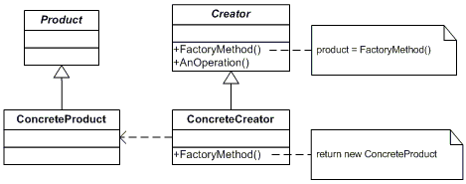
Factory Method Design Pattern Implementation
The classes and objects participating in this pattern are
Product - defines the interface of objects the factory method creates
ConcreteProduct - implements the Product interface
Creator - declares the factory method, which returns an object of type Product. Creator may also define a default implementation of the factory method that returns a default ConcreteProduct object. may call the factory method to create a Product object
ConcreteCreator - overrides the factory method to return an instance of a ConcreteProduct

Slide 11
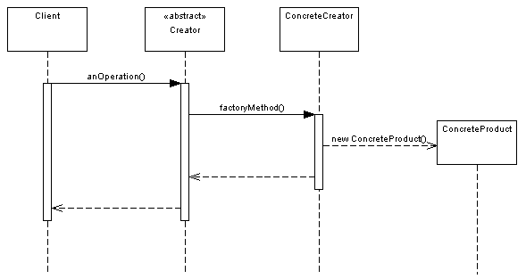
Factory Method Design Pattern Implementation
Now let's take a look at a sequence diagram to see how this pattern behaves: Here we see the client making a call to the abstract Creator, which then uses the FactoryMethod() to get a new instance of the ConcreteProduct, and completes the anOperation() method

Slide 12
Implementation
Step 1
Create an interface
Step 2
Create concrete classes implementing the same interface
Step 3
Create a Factory to generate object of concrete class based on given information
Step 4
Use the Factory to get object of concrete class by passing an information such as type

Slide 13
Example-1
Take into consideration a framework for desktop applications.
Such applications are meant to work with documents. A framework for desktop applications contains definitions for operations such as opening, creating and saving a document.
The basic classes are abstract ones, named Application and Document, their clients having to create subclasses from them in order to define their own applications.
For generating a drawing application, for example, they need to define the DrawingApplication and DrawingDocument classes. The Application class has the task of managing the documents, taking action at the request of the client (for example, when the user selects the open or save command form the menu).

Slide 14
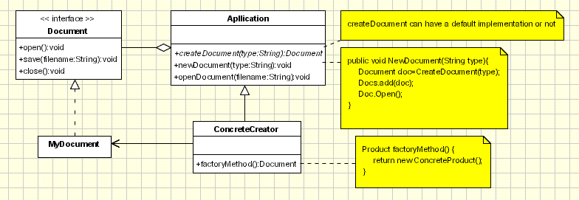
Example-1
Document class that needs to be instantiated is specific to the application, the Application class does not know it in advance, so it doesn't know what to instantiate, but it does know when to instantiate it. The framework needs to instantiate a certain class, but it only knows abstract classes that can't be instantiated.
The Factory Method design pattern solves the problem by putting all the information related to the class that needs to be instantiated into an object and using them outside the framework, as you can see below

Slide 15
Example-1
In the Application class the CreateDocument method either has a default implementation or it doesn't have any implementation at all, this operation being redefined in the MyApplication subclass so that it creates a MyDocument object and returns a reference to it.
public Document CreateDocument(String type){
if (type.isEqual("html")) return new HtmlDocument();
if (type.isEqual("proprietary")) return new MyDocument();
if (type.isEqual("pdf")) return new PdfDocument ();
}

Slide 16
Example-1
Assuming that the Application class has a member called docs that represents a list of documents being handled by the application, then the NewDocument method should look like this:
This method will be inherited by the MyApplication class and, so, through the CreateDocument method, it will actually instantiate MyDocument objects. We will call the CreateDocument method a Factory Method because it is responsible with 'making' an object. Through this method, redefined in Application's subclasses, we can actually shape the situation in which the Application class creates objects without knowing their type. From this point of view the factory method is pattern which provides us a way to achieve the DIP principle
public void NewDocument(String type){
Document doc=CreateDocument(type);
Docs.add(doc);
Doc.Open();
}

Slide 17
Factory Method Design Pattern in JDK
Best Example of Factory method design pattern is valueOf() method which is there in String and wrapper classes like Integer and Boolean and used for type conversion i.e. from converting String to Integer or String to double in java..
Some more examples of factory method design pattern from JDK is :
valueOf() method which returns object created by factory equivalent to value of parameter passed.
getInstance() method which creates instance of Singleton class.
newInstance() method which is used to create and return new instance from factory method every time called.
getType() and newType() equivalent of getInstance() and newInstance() factory method but used when factory method resides in separate class.

Slide 18
Home Assignment-2
Problem 1: Consider the toy molding factory. User needs different types of toy such as car, duck, horse, etc. based on his/her desire. There are different molds are available for specific toy and company may order new molds if required. When user selects a specific toy then plastic grains input to machine and user get required toy from machine.
Design the system and draw class diagram to use factory method pattern. Implement system in Java.

Slide 19
Home Assignment-2
Problem-2: System need to log the messages of the progress of the task in the system for various purposes such as debugging and monitoring progress. The log can be created in different formats like .txt, .html, database, xml, etc. User needs to select type of the log mechanism required for him at the time of configuring system.
Design the system and draw class diagram to use factory method pattern. Implement system in Java.

Slide 20
Home Assignment-2
Problem-3: Consider a mobile company, it has different plans of offers to different customers. To generate bills of the customer software needs to specify the plan that is associated with the customer thereby generating adequate bill of the customer. Currently there are plans such as prepaid plan, post paid plan, offer plan, etc. Final bill is generated based on plan and the consumed units.
Design the system and draw class diagram to use factory method pattern. Implement system in Java.

Slide 21
Home Assignment-2
Problem-4: Consider an online supermarket system. Different type of products can be added in the cart. Final billing of the shopping is based on the items selected in the cart. In advance type of item is not known to the system and it value.
Design the system and draw class diagram to use factory method pattern. Implement system in Java.

Slide 22
Home Assignment-2
Problem-4: Consider an online supermarket system. Different type of products can be added in the cart. Final billing of the shopping is based on the items selected in the cart. In advance type of item is not known to the system and it value.
Design the system and draw class diagram to use factory method pattern. Implement system in Java.

Slide 23
2. Singleton Design Pattern
In some applications, there is a need to have one and only one instance of a given class during the lifetime of an application
For example, we may need a single database connection object in an application.
Singleton should be considered only if all three of the following criteria are satisfied:
Ownership of the single instance cannot be reasonably assigned
Lazy initialization is desirable
Global access is not otherwise provided for

Slide 24

2. Singleton Design Pattern
The singleton class must provide a global access point to get the instance of the class
Singleton pattern is used for logging, drivers objects, caching, thread pool, and configuration settings etc.
The classes and objects participating in this pattern are:
Singleton
defines an Instance operation that lets clients access its unique instance
responsible for creating and maintaining its own unique instance

Slide 25
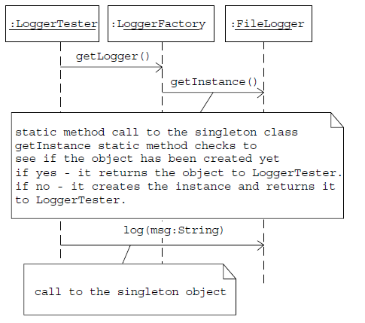
Singleton Design Pattern

Slide 26
Singleton Design Pattern
To create the singleton class, we need to have static member of class, private constructor and static factory method.
Static member: It gets memory only once because of static, it contains the instance of the Singleton class
Private constructor: It will prevent to instantiate the Singleton class from outside the class
Static factory method: This provides the global point of access to the Singleton object and returns the instance to the caller

Slide 27
Singleton Design Pattern
There are different approaches of Singleton pattern implementation and design concerns with the implementation
Eager initialization
Static block initialization
Lazy Initialization
Thread Safe Singleton

Slide 28
Eager initialization
In eager initialization, the instance of Singleton Class is created at the time of class loading
Easiest method to create a singleton class, but it has a drawback that instance is created even though client application might not be using it
public class EagerInitializedSingleton {
private static final EagerInitializedSingleton instance = new EagerInitializedSingleton();
//private constructor to avoid client applications to use constructor private
EagerInitializedSingleton(){} public static EagerInitializedSingleton getInstance(){
return instance;
}
}

Slide 29
Static block initialization
Static block initialization implementation is similar to eager initialization,
Instance of a class is created in the static block that provides option for exception handling
public class StaticBlockSingleton {
private static StaticBlockSingleton instance;
private StaticBlockSingleton(){} //static block initialization for exception handling
static{
try{
instance = new StaticBlockSingleton();
}catch(Exception e){
throw new RuntimeException("Exception occurred in creating singleton instance");
}
}
public static StaticBlockSingleton getInstance(){ return instance; }
}

Slide 30
Lazy Initialization
Lazy initialization method to implement Singleton pattern creates the instance in the global access method
Issue:
if multiple threads are inside the if loop at the same time, It will destroy the singleton pattern
Both threads will get the different instances of singleton class
public class LazyInitializedSingleton {
private static LazyInitializedSingleton instance;
private LazyInitializedSingleton(){}
public static LazyInitializedSingleton getInstance(){
if(instance == null){
instance = new LazyInitializedSingleton();
}
return instance;
}
}

Slide 31
Thread Safe Singleton
The easier way to create a thread-safe singleton class is to make the global access method synchronized, so that only one thread can execute this method at a time
It reduces the performance because of cost associated with the synchronized method
public class ThreadSafeSingleton {
private static ThreadSafeSingleton instance;
private ThreadSafeSingleton(){}
public static synchronized ThreadSafeSingleton getInstance(){
if(instance == null){
instance = new ThreadSafeSingleton();
}
return instance;
}
}

Slide 32
Home Assignment-3
Problem 1: Using SingletonPattern.java as a starting point, create a class that manages a fixed number of its own objects. Assume the objects are database connections and you only have a license to use a fixed quantity of these at any one time
Design the system and draw class diagram to use singleton pattern. Implement system in Java.

Slide 33
Home Assignment-3
Problem 2: Use Singleton pattern to create a counter to provide unique sequential numbers, such as might be required for use as primary keys in a database
Design the system and draw class diagram to use singleton pattern. Implement system in Java.

Slide 34
Home Assignment-3
Problem 3: Consider a dice game where multiple players play a game and their high-score is maintained. Identify the situations where singleton design pattern is applicable.
Design the system and draw class diagram to use singleton pattern. Implement system in Java.

